Slide 1
AVIATION FATALITY
Data insights using python and Tableau
By: Angela mwanzia
09/09/24

Slide 2
INTRODUCTION
I am here to present key insights from aviation fatality data.
This will help us understand accident patterns and make informed safety decisions.

Slide 3

Purpose of the Dashboard:
The dashboard analyzes aviation fatalities to identify trends and areas for improvement.
This analysis will shed light on the areas requiring attention for better aviation safety.

Slide 4

Data overview
Source of Data:
The dashboard covers global aviation fatalities, focusing on key factors like time, location, and causes.
Key Metrics:
The number of fatalities in different time periods.
Geographic distribution of accidents.
Patterns in fatalities across regions and airlines.

Slide 5
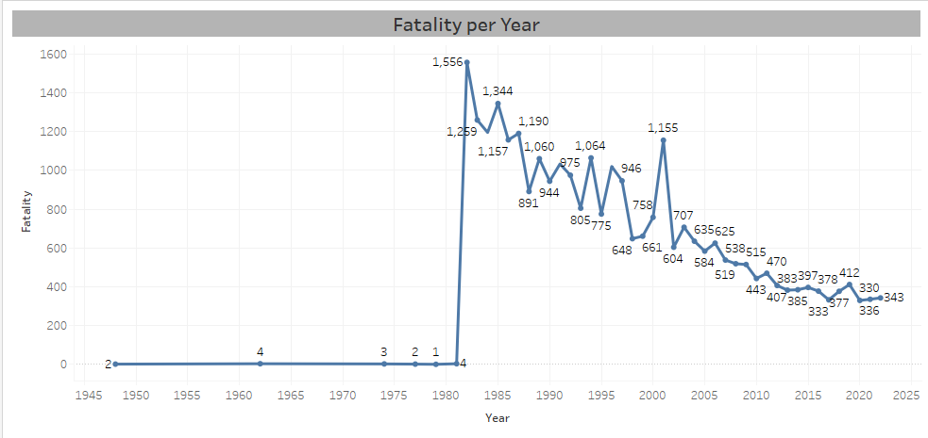
Fatalities by year
Main Finding:
Over the past few decades, the number of aviation fatalities has decreased.
Takeaway:
This is a positive sign, indicating that improvements in technology and safety regulations have had an impact.

Slide 6
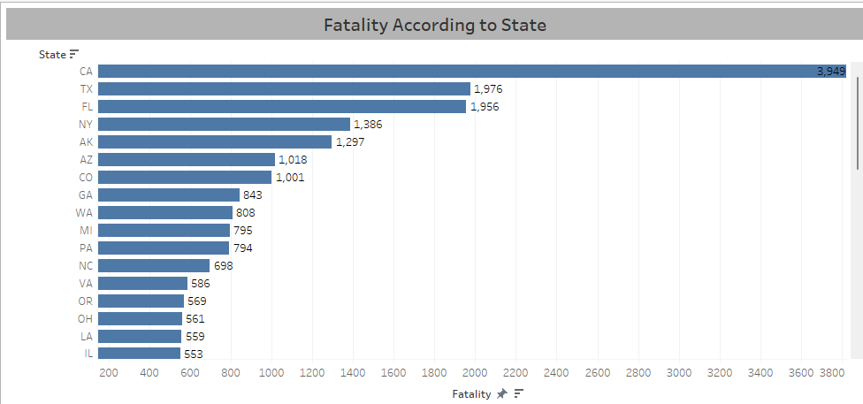
Fatalities by Region
Main Finding:
Some regions have a higher number of accidents, particularly in areas with high air traffic and looser safety protocols.
Takeaway:
Regional safety improvements can reduce accidents, especially in higher-risk regions.

Slide 7
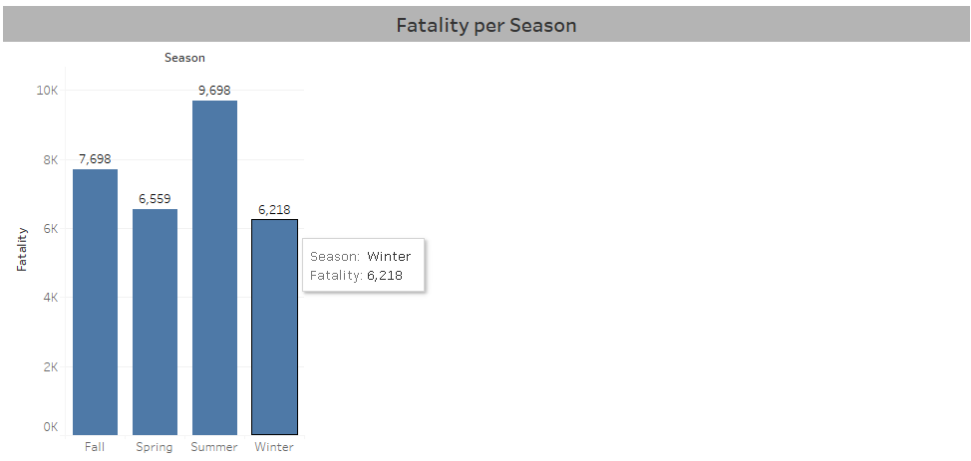
Fatalities by Season
Main Finding:
Summer has the highest fatalities indicating that the model of the airplane may have issues due to hot weather.
Takeaway:
The model components of the planes need to be maintained and invested on to ensure safety of the travellers.

Slide 8
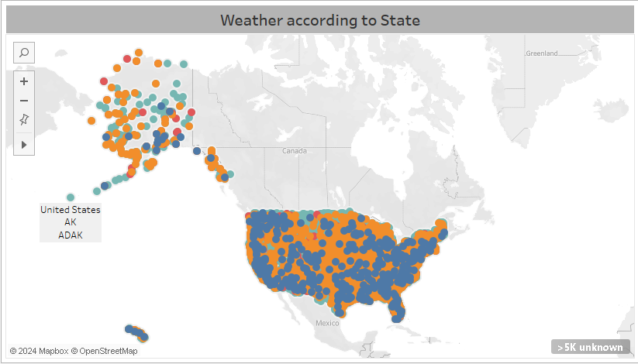
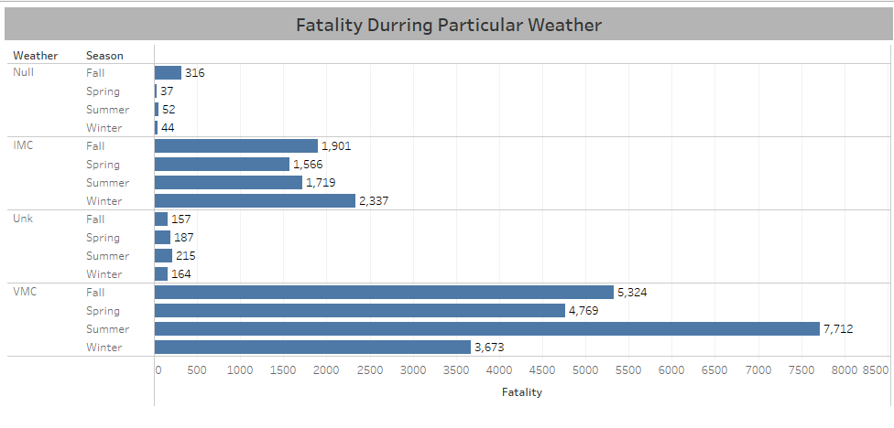
WEATHER, STATE , SEASON AND FATALITIES
Main Finding:
VMC has the highest number of fataliites indicating that the fault is either with the pilot , personel to make sure conditions are suitable or aircraft.
Takeaway:
It should be noted about the weather conditions that are safest and most risky to compare finding and come up with sollutions on what to do to decrease fatalities.

Slide 9

Actionable Recommendations
Summary of Insights:
Fatalities are decreasing globally.
Regions and operators still face risks.
Critical flight phases like takeoff and landing need extra safety precautions.
Recommendations:
Regional Safety Audits: Focus on improving safety in high-risk areas.
Operator-Specific Strategies: Develop tailored safety strategies for airlines with higher fatality rates.
Phase-Specific Safety Measures: Invest in pilot and crew training, particularly for takeoff and landing.

Slide 10
Conclusion
Key Message:
Aviation safety has improved, but there are still regions, operators, and flight phases that need attention.
Next Steps:
By focusing on high-risk areas and critical phases of flight, we can continue to improve global aviation safety.

